Slide 1
Broadcast Audio over IP Axia Livewire
Presented by Darryn Smith
AVC Group Business Development Manager
Notes:
Welcome, introduce myself. Telos Alliance history. As the agents for Axia this technical workshop will have a slight sales flavour to it but its important to note that because Axia Livewire Audio over IP is completely standards based, the same fundamental ideas can be transferred to other AoIP providers. However, it is important to note the difference between providers that offer digital products but that aren’t AoIP. So, I’m going to give you a very brief over of AoIP before we start putting together an Axia Livewire system.

Slide 2
Analogue, Digital and AoIP
Analogue – typically point-to-point wiring with the later systems using TDM.
Digital – relatively new console systems whereby the internal console system may be digital or it may use digital connections (such as AES/EBU or MADI) back to a central card cage or router. These systems are based on the analogue framework.
AoIP – based on a highly reliable, IP standards based distributed network where every source and destination is automatically made available to each other. Not to be confused with proprietary systems that use network cable but don’t adhere to IP standards.
Notes:
Draw routing table, TDM card cage expansion and then a typical network diagram showing multicast. Show how the Axia routing table can be expanded simply by plugging in a node.

Slide 3
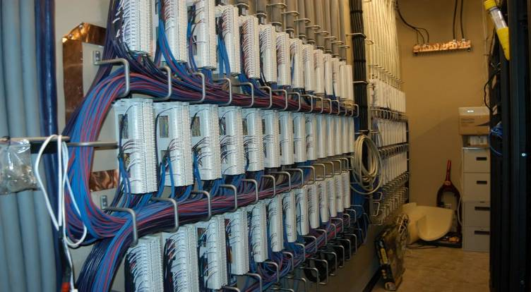
Reduced Wiring and Terminations
This facility is “all digital”. But the TDM routing methodology requires a huge wire and labour commitment.

Slide 4
Axia AoIP - Livewire
Livewire is a standards based Ethernet transport system which operates on levels 1 to 5 of the 7 layer Open Systems Interconnection (OSI) reference model.
Livewire is essentially an open framework with two other console manufacturers integrating a Livewire port and many other hardware and software manufacturers adopting Livewire functionality.
Axia consoles also integrate with your existing analogue infrastructure if you’d prefer to look at a Livewire network as a future option or just use them as a standalone console.

Slide 5
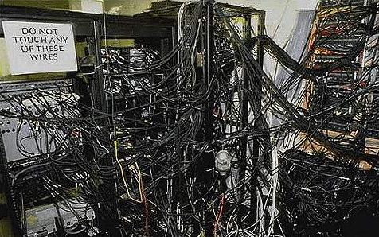
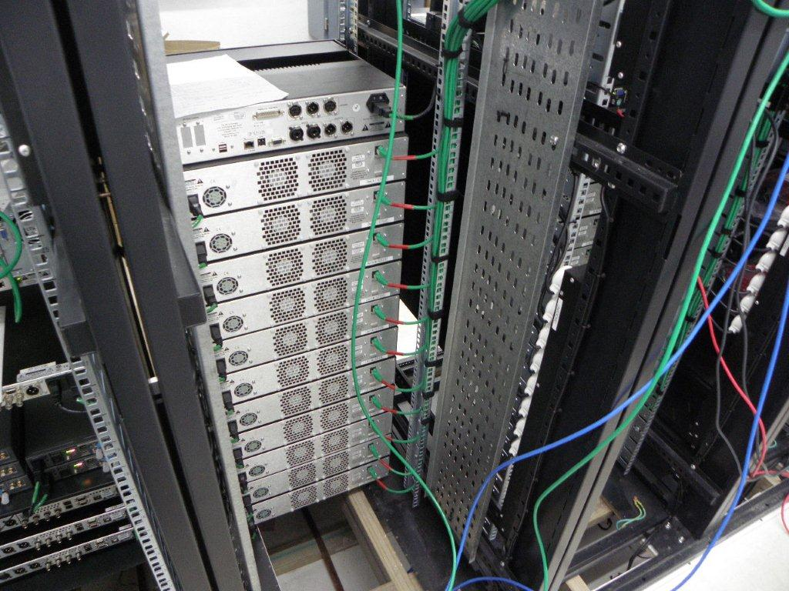
Your office LAN – wired as if networking were never invented.
Or with Audio over IP

Slide 6
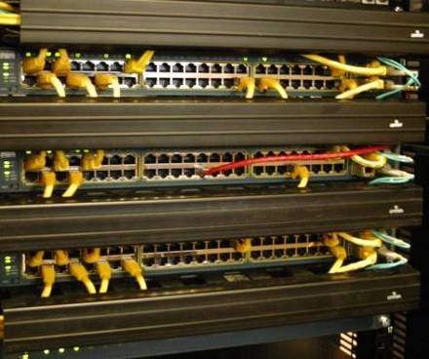
Reduced Wiring and Terminations
Here are all the audio network terminations for five of MPR’s control rooms. Over 500 stereo routes are active in this photo, with capacity for over 1,500.

Slide 7
Ethernet and IP are Standards
Why are Ethernet and IP such a great way to move audio data around? For one thing, they are well established, bonafide standards. (Ethernet is defined in IEEE 802.3, while IP is specified in a number of IETF standards, starting with RFC 1122; both can trace their roots back to the 1980s.) Instead of inventing a whole new system to route audio, IP networks take advantage of long-existing, widely deployed, and highly reliable computer-industry technology for data routing. (After all, audio is no different than any other kind of data.) Standards make equipment future-proof: Ethernet is an open standard that all its users must adhere to, which means that any device with an Ethernet port will work with any other device that has an Ethernet port — period, no exceptions.
When technology has a consistent framework for development, ongoing improvements pay off in increased performance. A standard also guarantees that new gear will always be compatible with existing gear. There are no expensive, proprietary systems to buy and maintain, or to try and custom-engineer interfaces to someone else’s designs. Being standards-based means that IP networks just work — you plug them together and the data flows.

Slide 8
“Free” R&D: Ethernet is a mainstay of the consumer and business computing sector. Heavyweight technology companies like Cisco and HP invest billions of dollars annually into R&D for their Ethernet switching products, which results in continual improvement to the performance of Ethernet networks. Using Ethernet to move broadcast audio lets us leverage those huge R&D investments from the computing industry to benefit broadcasters and reduce costs.
Easily expandable: Compared to traditional studios built with discrete audio circuits or time-domain multiplexing (TDM) technology, IP networks can be easily expanded. When you run out of room in the card-cage with a TDM system, you have to purchase an additional (expensive) duplicate, whether or not you need all of its capacity. Conversely, IP-based studios are economical and easy to expand by simply plugging new nodes and switches into the network a la carte — the same way you’d expand any computer network.

Slide 9
Sample studio connection

Slide 10
IP Networks cost less to install
Decreased cabling costs: Ethernet can carry huge amounts of audio-as-data, yet requires much less cabling and infrastructure than other methods of studio interconnection. Thus the cost of cabling is markedly decreased. For example, if you look in your studio ceilings, you’ll probably find 100-pair audio cables crawling through them. One of these can carry 50 channels of analog stereo audio (or 100 channels of AES3 digital stereo). And, of course, it needs to have connectors — typically 100 XLRs soldered to each end. These cables and connectors get more expensive all the time, and a lot of time is required to hand-solder that many connectors. A spot check finds that the cheapest 100-pair cable costs around $3 per foot; XLRs in bulk are about $2.25 each. So, to run one of these through your facility for 100 yards will cost you about $1,400, plus labour. Remember, that’s for 50 to 100 channels of stereo audio only — no control circuits or paths for any other information.
By contrast, a single CAT-5e Ethernet cable can carry around 25 simultaneous channels of 48-kilohertz, 24-bit broadcast-quality stereo digital audio — plus start/stop logic and other data, like song titles, playlist information, automation control data, and other traffic (such as e-mails and file transfers).
CAT-5e costs around $0.35 per foot, so the two such paths required to match the (analog) audio capacity of the 100-pair cable noted above would cost around $210, an 85 percent savings. (To match the AES3 digital audio capacity, the four CAT-5e paths required cost about $420, or a 70 percent savings.) And there aren’t hundreds of XLRs to solder — just a few RJ-45s, which add pennies to the total — so labour cost and installation time are greatly reduced, as well.

Slide 11
Decreased complexity: In the old days, sharing the audio from gear in your equipment room meant running wires to every studio where you wanted that audio to appear — a monstrous task requiring multiple redundant cables and plenty of costly installation time and labor. But in an IP-connected facility, any device connected to the network can share its audio with any or all other locations, all via a single connection to each device.
Also, since one Ethernet cable does the work of many discrete ones, installation is simplified. For example, IP-enabled devices, like the facility’s playout computer, phone system, or satellite receiver, can each connect to the routing system using a single Ethernet cable instead of multiple discrete pairs. There are dozens of broadcast equipment manufacturers who make equipment that connect this way today, and the list is growing all the time. You probably already have some of this IP-ready equipment in your facility. And of course, most computer-based products like automation or editing systems intrinsically have Ethernet ports. For these, a software driver emulating a sound card connects them to the network, saving the cost of expensive sound cards, as well as eliminating the need for the cables and engineering labor to wire them up.
Older gear that doesn’t have Ethernet connectors can work with IP networks, too. RJ-45 adapters are used to connect older equipment like CD players, DAT decks, and other existing hardware (see photo), while speakers, mics, headphones, and other devices can be accommodated via inexpensive interfaces. The whole thing goes together in a quarter of the time it would take to wire up a conventional studio, and typically costs only about a third of the traditional cost to build.

Slide 12
XLR, TRS, RCA to RJ45 – not a problem!

Slide 13
IP Networks use resources more efficiently
So far we’ve concentrated on the cost advantages of IP studios. At this writing, there are over 2,500 radio facilities around the world using these networks, and the savings in equipment cost, installation time and labour, and ongoing maintenance have been well documented. But there’s another yardstick we can measure them with.
Shared equipment: In the same way that a computer connected to the network can share the contents of its drive with others, a networked audio device can be used and controlled by talent in any other studio. Why buy separate remote codecs for every studio, for example, when you can put just one or two in your terminal room that all studios can share? Satellite receivers and broadcast phone systems can share their resources in a similar fashion. One audio processor can be shared between all production rooms, as well.
Time management: If engineers can eliminate travel time to the studios during emergencies, their abilities are put to use faster, and the station is back on the air sooner. Studios connected to an IP network can be accessed remotely via a secure connection, so engineers can log in from anywhere with Internet access to check network conditions, make administrative tweaks, perform remote troubleshooting, or help a jock out of a jam.

Slide 14
IP networks are ready for Radio’s future
Tested and proven, future-proof: Audio over IP is not “future tech.” It’s been successfully deployed at thousands of radio facilities worldwide over the past eight years, and is a tested, proven standard.
And of course, IP itself and the Ethernet backbone it travels over have been refined and enhanced by two decades of real-world use in hardened, 24/7 facilities.
Since IP-audio networks speak the same language as computers, they’re able to take advantage of whatever new computer networking technology is yet to come — meaning your studios are essentially future-proof.

Slide 15
Axia Livewire Audio over IP
AoIP provides numerous advantages:
Savings in costs and time during installation and with maintenance
Compatibility - Axia Livewire is designed to allow all standard broadcasting equipment to simply ‘plug-in’
Standards Based - Axia Livewire uses standard Ethernet protocols making it future proof by design
Easy to use and configure for how you want to use it – ensures a good transition from older equipment

Slide 16
THANKS FOR LISTENING!

Slide 17
Axia Radius Console and QOR.16

Slide 18
How to set up an Axia AoIP console
Connect the Canbus cable from the console to the QOR.16
Connect all inputs and outputs to the QOR.16
Power on
Set IP address, subnet and gateway on Console
Set PC/laptop IP address to same range
Put QOR.16 IP address into a browser window to access the engine web based setup

Slide 19
How to set up an Axia AoIP console
Set up each input and output
Create a source profile
Create a show profile
Set up control logic – e.g. red light controller or HP304

